Slide 1
ProdPal Web Chat
*An AI Assistant with Lambda Logs Integration*
GitHub Branch: vanguardgifs/chathackathon

Slide 2
What is ProdPal?
AI chatbot for answering product & service questions
Combines two powerful capabilities:
Retrieval-Augmented Generation (RAG)
AWS Lambda logs integration
Provides accurate answers with context from system errors
Familiar chat interface similar to ChatGPT/Claude

Slide 3
The Problem We're Solving
For Support Teams: Need accurate, knowledge-based responses
For Developers: Need quick troubleshooting in serverless environments
For Customers: Need consistent, reliable answers
Common Issue: Traditional chatbots lack awareness of system errors

Slide 4
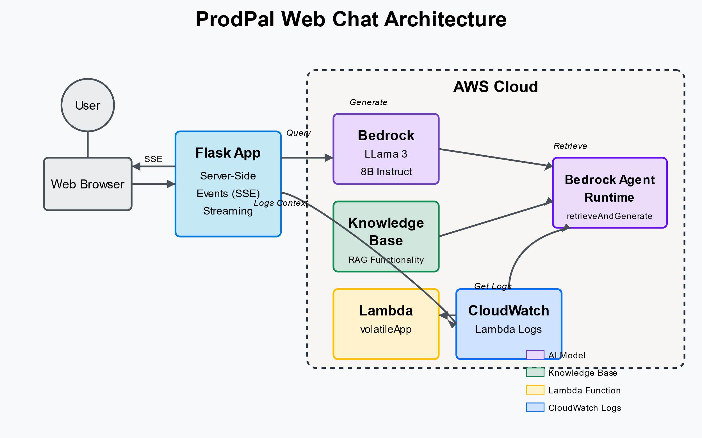
Technical Architecture

Slide 5
How It Works
1. User asks a question in the chat interface
2. Backend retrieves relevant Lambda error logs
3. Logs + question sent to AWS Bedrock retrieveAndGenerate API
4. Model generates response using knowledge base + logs context
5. Response streamed back with citation markers
6. Citations provide source transparency (Knowledge Base vs Logs)

Slide 6
Key Feature: Lambda Logs Integration
Automatically retrieves logs from specified Lambda function
Refreshes hourly, with manual refresh option
**Smart Filtering:** Only includes error-related log lines
Filters for: 'error', 'exception', 'fail', 'traceback', etc.
Includes filtered logs in context for every query
No need to explicitly mention "logs" in queries

Slide 7
Key Feature: Citation System
Responses include numbered citations ([1], [2], etc.)
Citations indicate source on hover:
"Knowledge Base: [source]"
"Log: [source]"
Helps users understand where information came from
Builds trust through transparency

Slide 8
Key Feature: Streaming Responses
Responses appear progressively as they're generated
Creates engaging, natural typing effect
Implementation:
Chunks response based on punctuation
Uses Server-Sent Events (SSE) for streaming
Simulates typing delay for natural flow

Slide 9
Live Demo

Slide 10
Future Enhancements
Real-time log streaming integration
Support for multiple Lambda functions
Enhanced citation formatting and visualization
Integration with additional knowledge sources
Custom training for product-specific terminology

